Slide 1
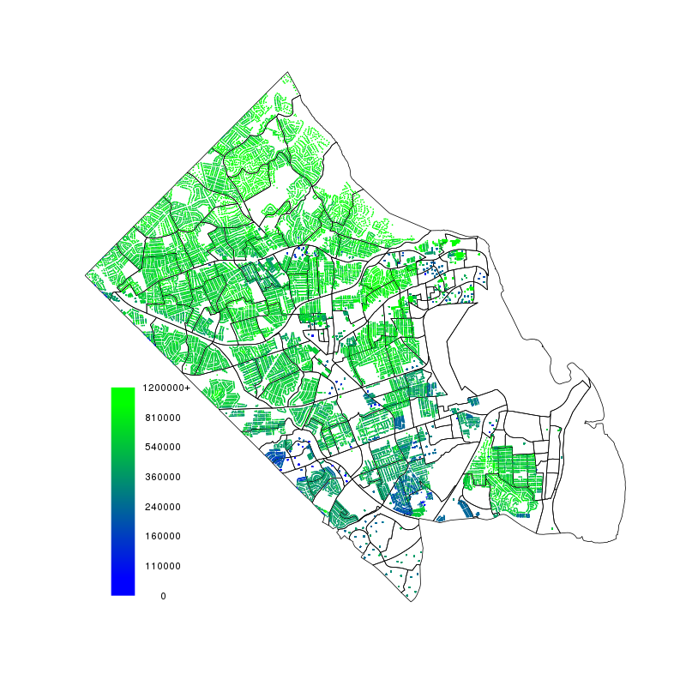
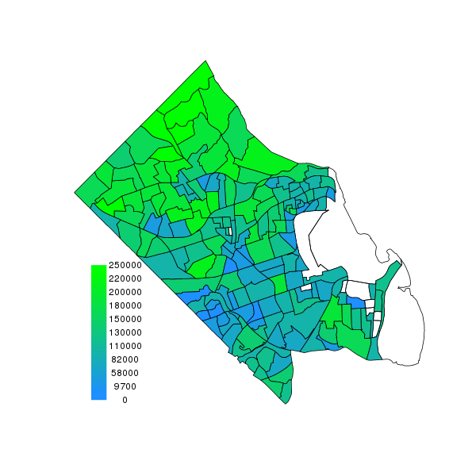

Combining federal, administrative, and local data for community surveillance
Josh Goldstein, SDAL, Virginia Tech
Ian Crandell, SDAL, Virginia Tech
Dawn Haisey-Grove, MITRE
Kevin Gormley, MITRE
Emily Molfino, US Census
Dave Higdon SDAL, Virginia Tech
Sallie Keller, SDAL, Virginia Tech
Stephanie Shipp, SDAL, Virginia Tech
Shawn Buckholtz, US HUD

Slide 2
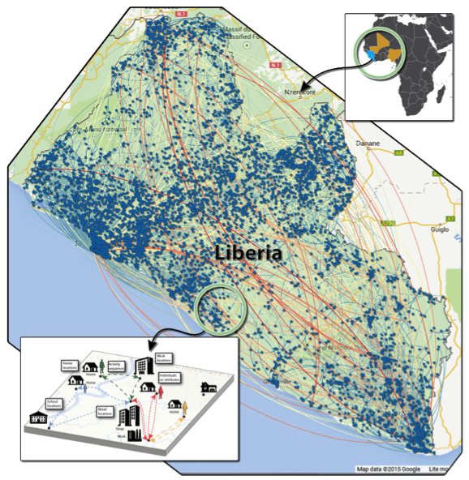
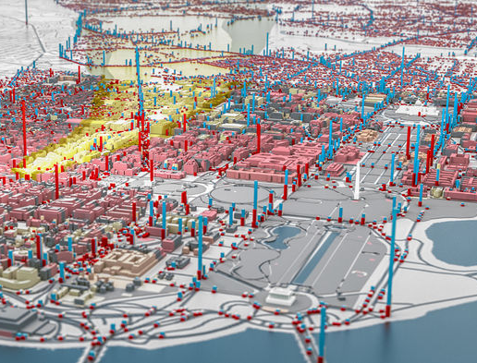
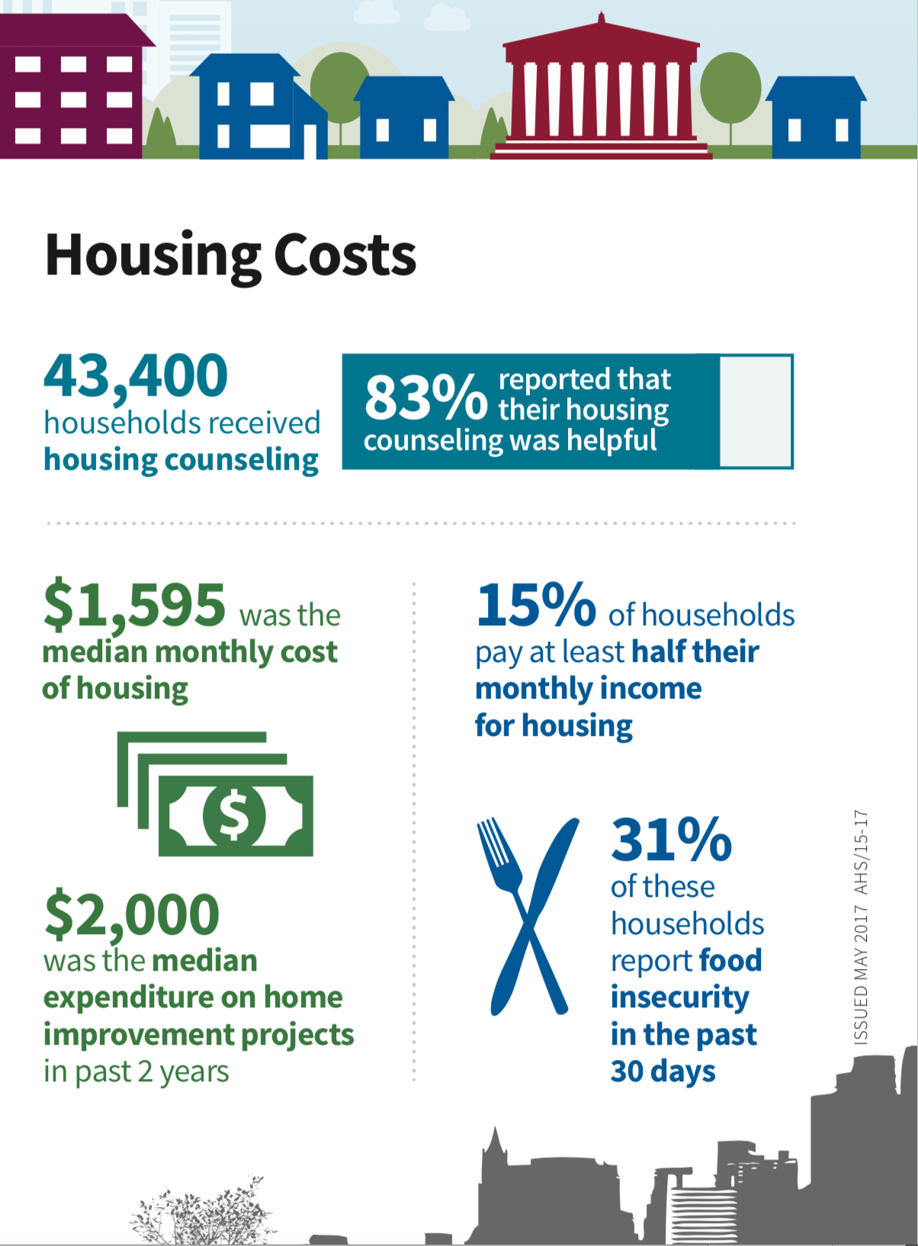
Synthetic Populations
Simulations and Agent-based Models
Planning
Assessing Surveys

Slide 3
Standard Approaches for Constructing a Synthetic Population
Approaches
unknown
Iterative proportional fitting (IPF)
Annealing
Model-based
Issues
Often replicates individuals
Solution not unique
Uncertainty not well characterized

Slide 4
Spatial Models: Uncertainty & Data at Different Levels of Aggregation
Spatially linked data provide additional information about the spatial process: the average over spatial region 1; the value at location 2; and the average over spatial region 3.
The prior model for the spatial process specifies the spatial dependence and variability that is appropriate for this process.

Slide 5
Population Models: Data at Different Levels of Aggregation
The prior model specifies the spatial location of each individual and requires the overall proportion of blue individuals to be near .6 to be consistent with survey data from this population.
Spatially linked data provide additional information about the proportion: proportion of blue individuals in spatial region 1; the color of the individual at location 2; and the proportion of blue individuals in spatial region 3.

Slide 6
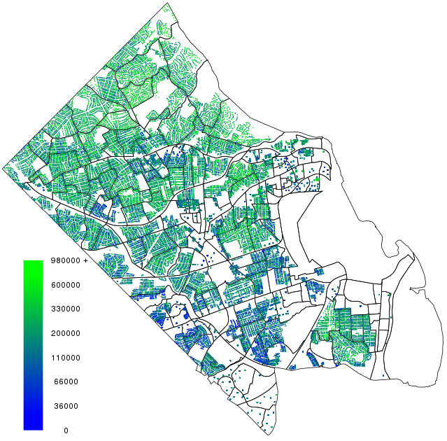
Use data at different levels of aggregation / support to inform at the individual level
Statistical
Sample
Local Data
housing price
tax amount from real estate tax assessments
ACS
Income summary
- by block group
ACS Microdata
housing price
tax amount
income
- county sample
Household level Imputation
housing price
tax amount
income

Slide 7
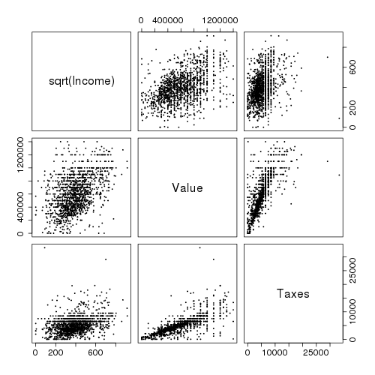
Use data at different levels of aggregation / support to inform at the individual level
Local Data
housing price
tax amount from real estate tax assessments
ACS
Income summary
- by block group
ACS Microdata
housing price
tax amount
income
- county sample
Household level Imputation
housing price
tax amount
income

Slide 8
“Posterior” and a Sampling Approach
x₁ x₂
●
● ● ● ● ● ● ● ● ● ● ● ● ● ●
● ● ● ● ●
x₂
●
●
●
●
sample
x₁
Use M-H update scheme:
x¹
x²
x^{T}
● ● ● ● ● ● ● ● ●
○ ○ ○ ○ ○ ○ ○ ○ ○
● ● ● ● ● ● ● ● ●
○ ○ ○ ○ ○ ○ ○ ○ ○
● ● ● ● ● ● ● ● ●
○ ○ ○ ○ ○ ○ ○ ○ ○
region 1
x₂
• • •
region 2
x₂
draws from

Slide 9
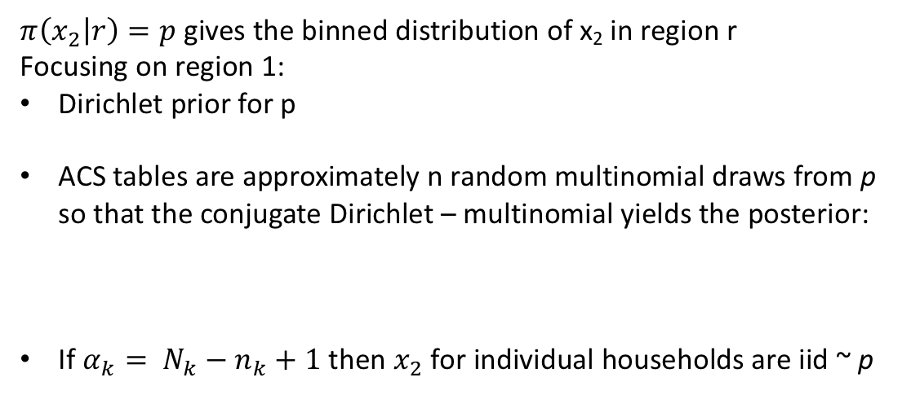
Choice of distribution I
x₁ x₂
Table gives discrete information about x₂
●
● ● ● ● ● ● ● ● ● ● ● ● ● ●
● ● ● ● ●
x₂
●
●
$π\left(x_{2} | r\right)=p$ gives the binned distribution of x₂ in region r
Focusing on region 1:
Dirichlet prior for p
ACS tables are approximately n random multinomial draws from p so that the conjugate Dirichlet – multinomial yields the posterior:
If $α_{k}= N_{k}−n_{k}+1$ then $x_{2}$ for individual households are iid ~ p
●
●
sample
x₁
p₁ p₂ p₃ p_{K}
region 1
1 2 3 K
x₂
region 2
x₂

Slide 10
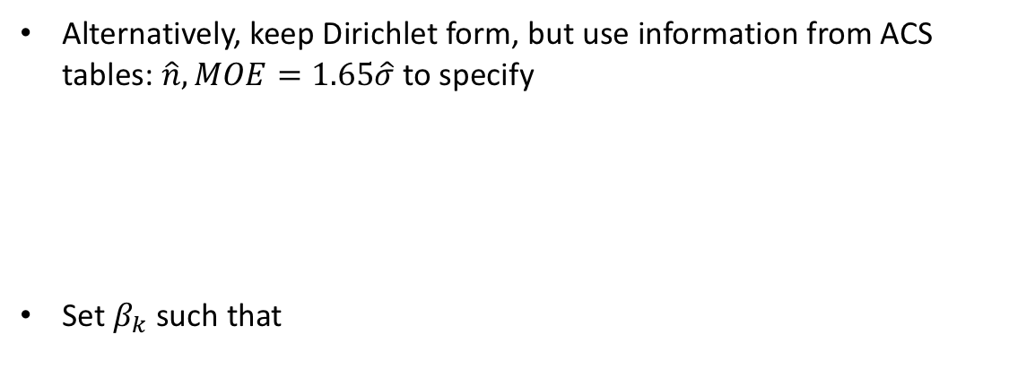
Choice of distribution II
x₁ x₂
●
● ● ● ● ● ● ● ● ● ● ● ● ● ●
● ● ● ● ●
x₂
●
●
Alternatively, keep Dirichlet form, but use information from ACS tables: $\hat{n}, MOE=1.65\hat{σ}$ to specify
Set $β_{k}$ such that
●
●
sample
x₁
p₁ p₂ p₃ p_{K}
region 1
1 2 3 K
x₂
matches ACS estimates
region 2
x₂
matches average ACS MOE
matches ACS proportions. Choose $β_{+}$ to give a reasonable match to the various MOE’s.

Slide 11
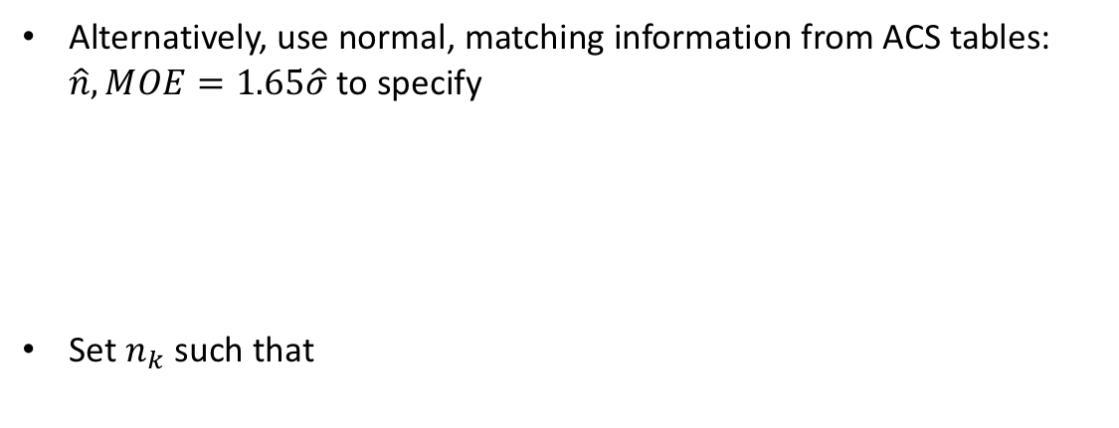
Choice of distribution III
x₁ x₂
●
● ● ● ● ● ● ● ● ● ● ● ● ● ●
● ● ● ● ●
x₂
●
●
Alternatively, use normal, matching information from ACS tables: $\hat{n}, MOE=1.65\hat{σ}$ to specify
Set $n_{k}$ such that
●
●
sample
x₁
p₁ p₂ p₃ p_{K}
region 1
1 2 3 K
x₂
matches ACS estimates &
matches average ACS MOE
region 2
x₂

Slide 13
Example: Assessing uniqueness of AHS microdata samples
dwelling area
dist to water
# bedrooms
hh income
hh size
hh size
hh income
all housing units
hh size
hh income
housing units in apartments
hh size
hh income
Population
real estate
tax data
A-track data
SRS of apartments
AHS PUMS
SRS of hh
ACS Tables – aggregated by block group

Slide 14
Variables Used to Inform Population Distribution
Renters
Household Income
Bedrooms
Rent
Year Built
Within a half block of water
Owners
Household Income
Property Value
Real Estate Taxes
Bedrooms
Bathrooms
Living Area
Year Built
Within a half block of water

Slide 15
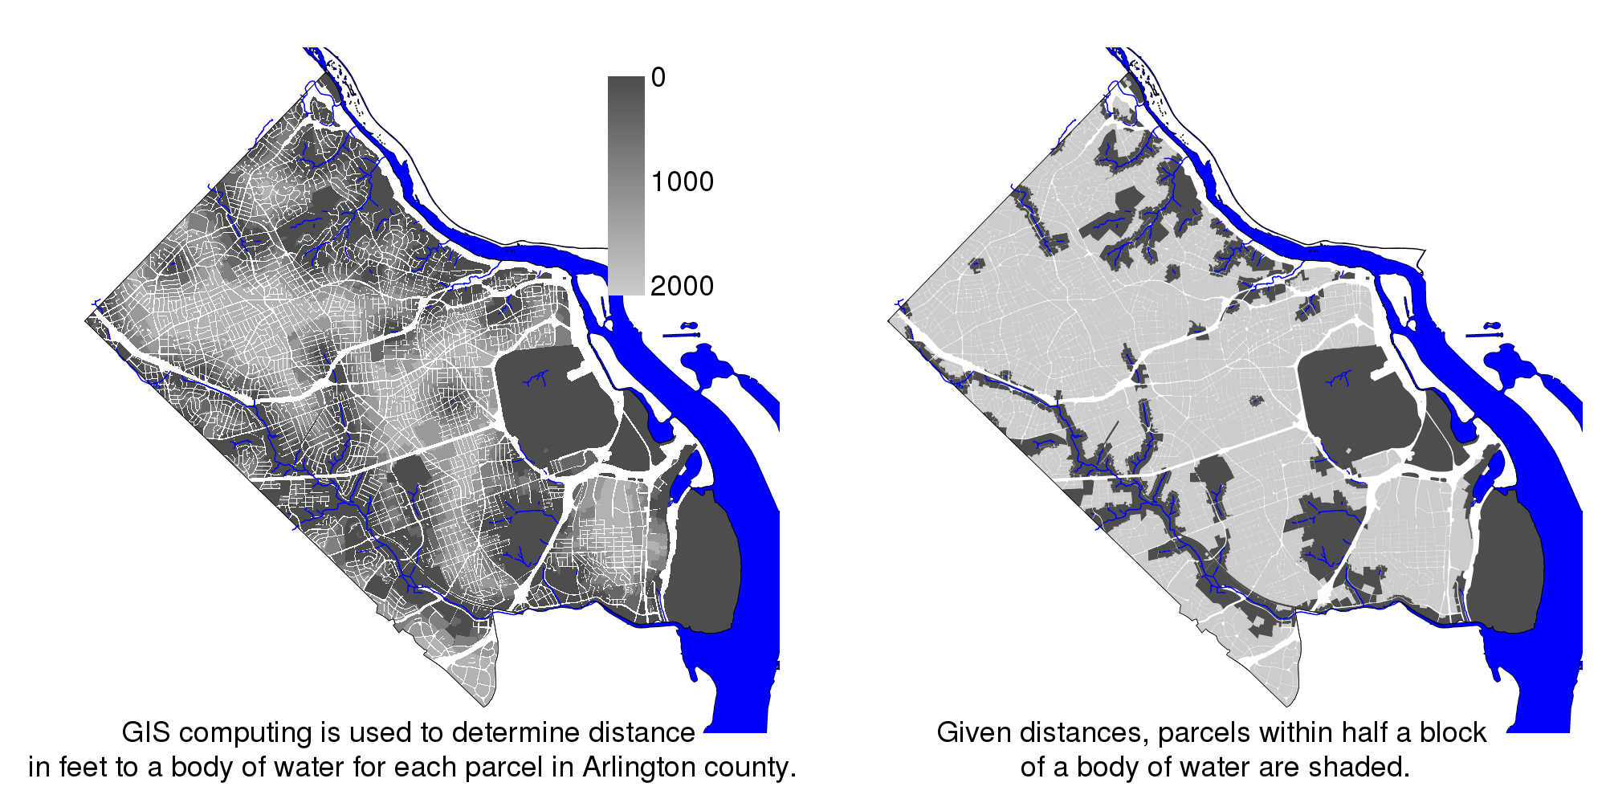
Direct Determination of Geographic Variables

Slide 16
More Generally
x₁ x₂ x_{K}
● ● ● ● ● ● ● ● ● ● ● ● ● ●
● ● ● ● ●
● ● ● ● ●
● ● ● ● ●
● ● ● ● ●
tables
apartments
opportunity data
survey data
sample
region 1
●
x_{j}
●
region 2
x_{j}
●

Slide 17
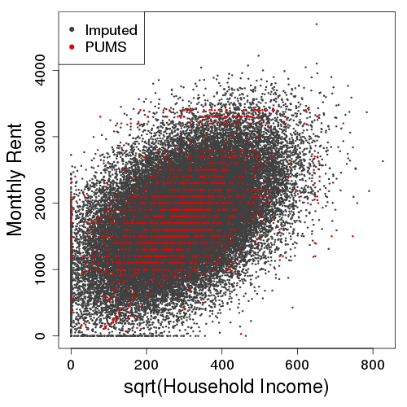
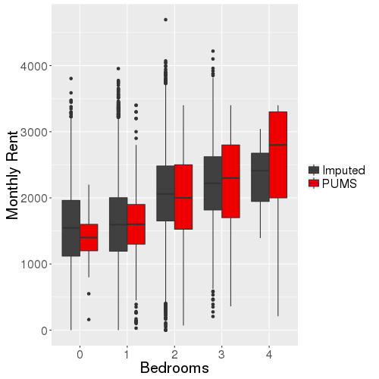
Results – Conditional Distributions
Imputed variables have conditional distributions consistent with those observed in the PUMS

Slide 18
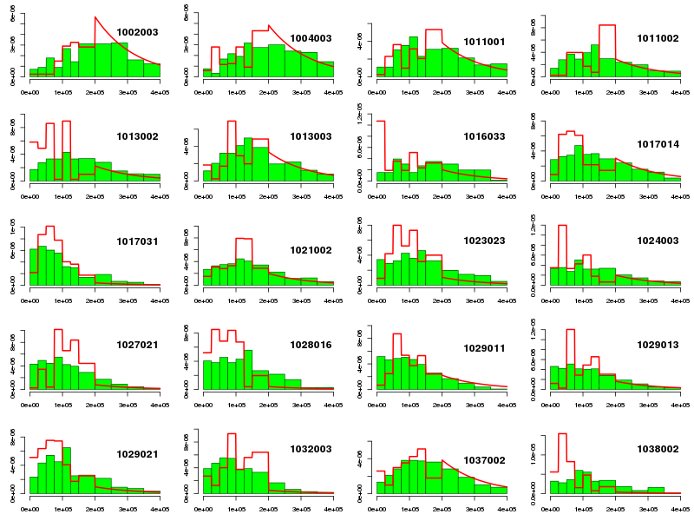
Using only microdata
blockgroup id
household income

Slide 19
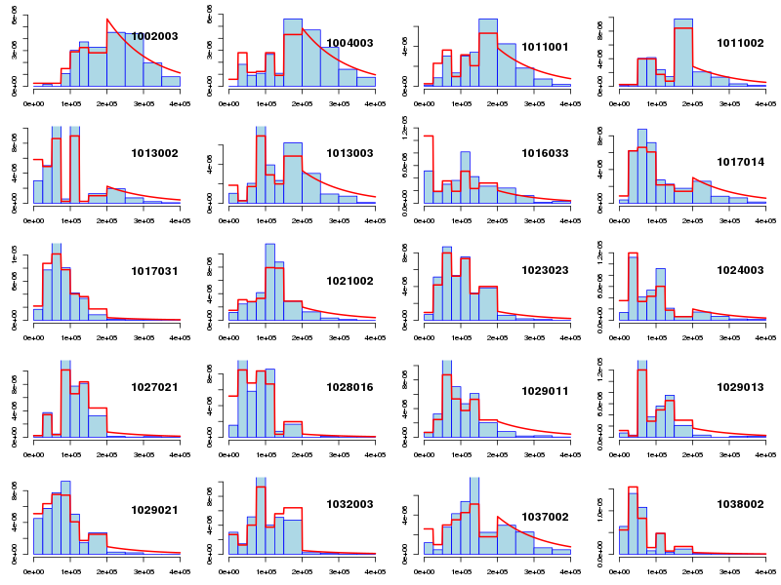
Also using marginal table information
blockgroup id
household income

Slide 20
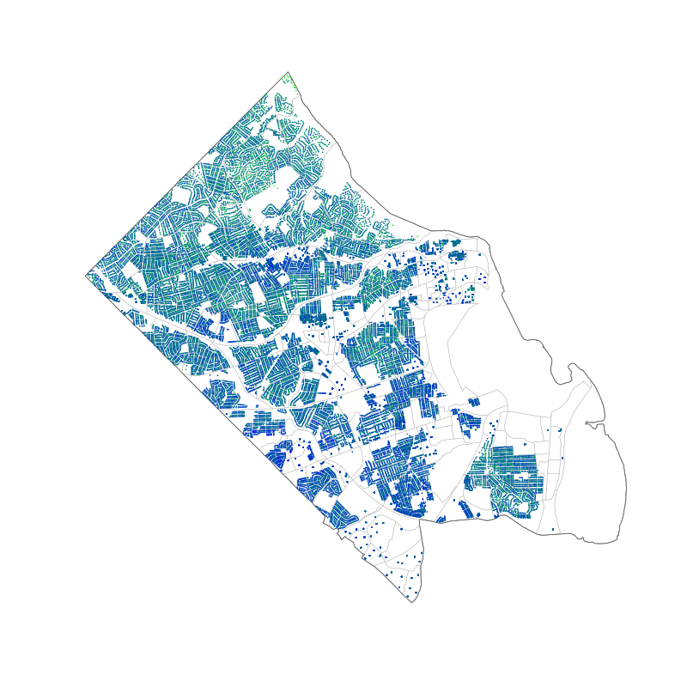
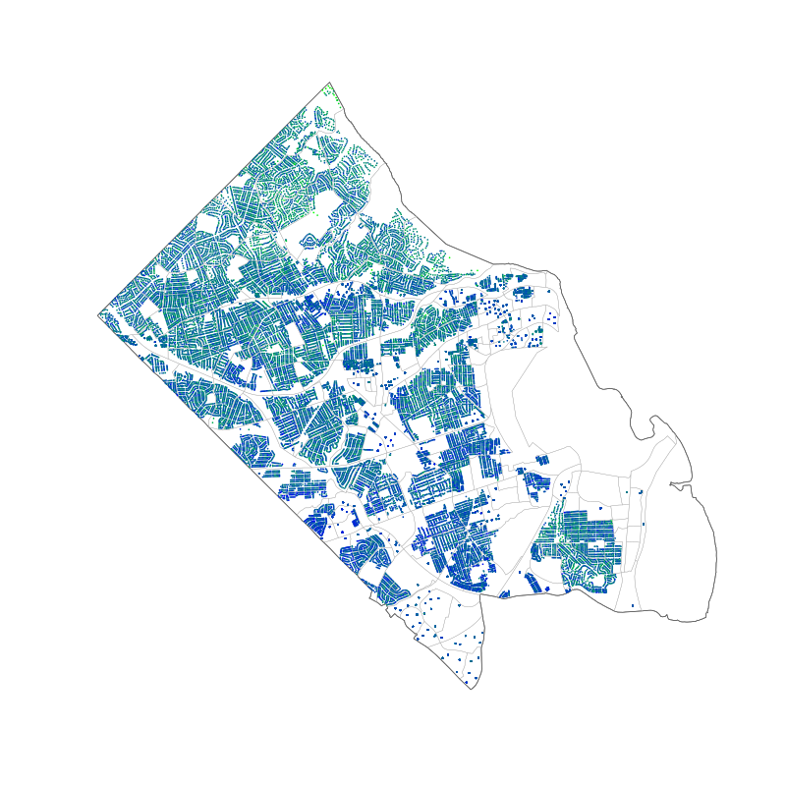



Posterior Realizations
Realizations of household income
Uses information from:
real estate tax records,
geography, county GIS data
American Community Survey microdata,
American Community Survey (blockgroup) summaries of:
household Income, property value, # bedrooms, year built
County apartment surveys

Slide 21
Assessing uniqueness with these realizations of Arlington
pseudo universe records
number of matches
housing unit
household
geography
unique records match only to themselves (n_{i} = 1).
a record may include values of variables describing its housing unit, geography, and household
compare each record to all records in the pseudo universe
sum the number of matches n_{i} for each sample record i
a low number of matches (e.g. 1 ≤ n_{i} ≤ 3) indicates a risk of disclosure
Matching tolerances:
Bedrooms, Bathrooms: 0-4 exact match, 5+ matches from 4-Inf
Year Built: +/- 15 years
Water Flag: Exact Match ("1" or "0")
All the other continuous variables: +/- 25%

Slide 22
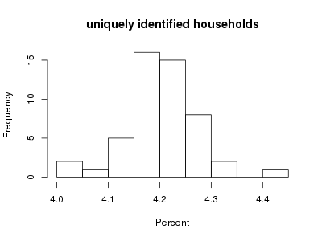
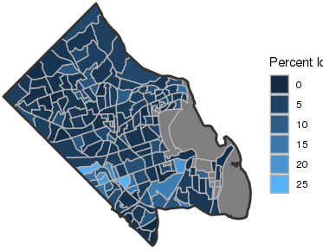
Assessing uniqueness with these realizations of Arlington
% unique
Matching tolerances:
Bedrooms, Bathrooms: 0-4 exact match, 5+ matches from 4-Inf
Year Built: +/- 15 years
Water Flag: Exact Match ("1" or "0")
All the other continuous variables: +/- 25%
Our probabilities of identifiability are likely overstated
respondents do tend to give answers to survey questions that do not match ours exactly
Identifiability depends on tolerances

Slide 23

Combining local data sources with a probabilistic representation of the local community
Posterior Realizations
incorporate information and uncertainty in data combination
housing units
Combine using state of the art concepts from:
Multiple Imputation
Synthetic population generation
Bayesian Computation
Generate plausible fine scale configurations of the population/system for prediction and quantifying uncertainty.
demographics
Multiple data sources at various levels of aggregation.
realization 1
realization 2
•••
realization T
Local data sources relevant to understanding factors relating to domestic abuse calls:
Real estate tax records
Demographics (e.g. American Community Survey)
Local Police Responses
Local EMS Medical Responses
References:
Reiter, J. P., & Raghunathan, T. E. (2007). The multiple adaptations of multiple imputation. Journal of the American Statistical Association
Buuren, S., & Groothuis-Oudshoorn, K. (2011). MICE: Multivariate imputation by chained equations in R. Journal of Statistical Software
Beckman, R. J., Baggerly, K. A., & McKay, M. D. (1996). Creating synthetic baseline populations. Transportation Research Part A: Policy and Practice
Besag, J., Green, P., Higdon, D., & Mengersen, K. (1995). Bayesian computation and stochastic systems. Statistical Science
P(call)
P(call)
domestic abuse calls
local
indicator
Statistically generated realizations allow separation of signal and noise at the local level.

Slide 24
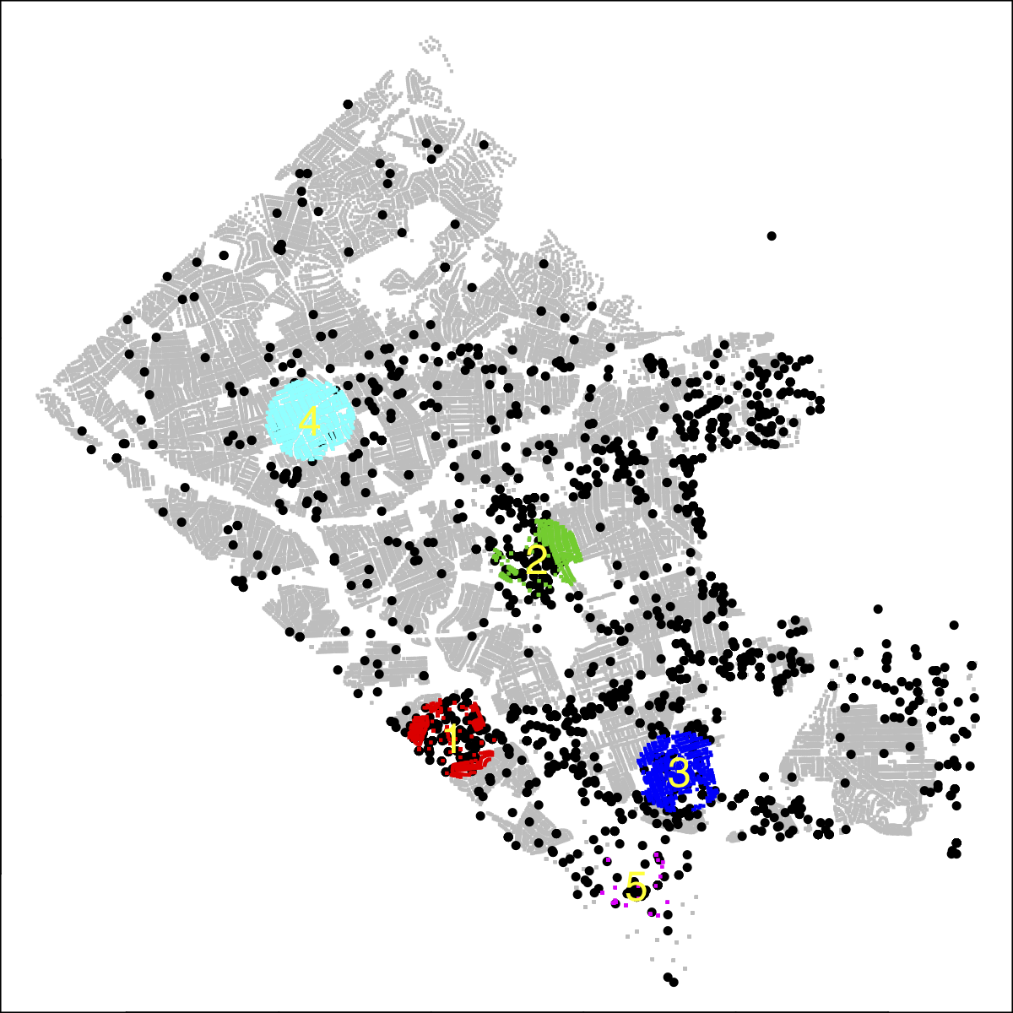
Local Association between Domestic Dispute Call Rates and Income
2
1
Only proof of principle at this stage
Call rates vary substantially by local region
Region 3 may show a different trend compared to the other regions

Slide 25
Discussion Points
Our probabilities of identifiability are likely overstated
respondents do tend to give answers to survey questions that do not match ours exactly
Identifiability depends on tolerances
Pairing up population with point level events
e.g. local neighborhoods and domestic violence
Change of support for aggregated data
e.g. combining aggregates by school district and political districts

Slide 26
Individual inferences are difficult with aggregated data
Relationships of aggregates typically overstate the strength of the relationship.
Aggregates do not show relationships at the individual level
Data are commonly released giving information aggregated over spatial regions
Different data sources often use different aggregation units (e.g. school districts vs counties)
Health and policy actions take place at the individual level
From Statistics by Freedman, Pisani & Purves

Slide 27
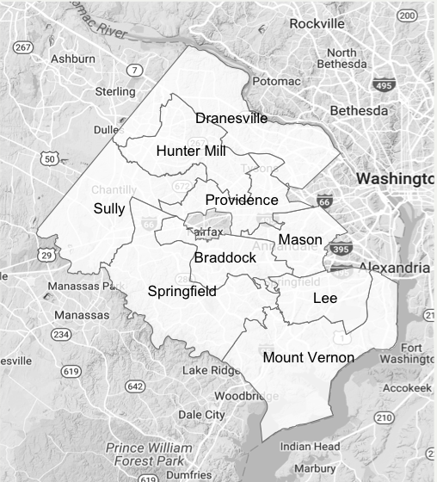
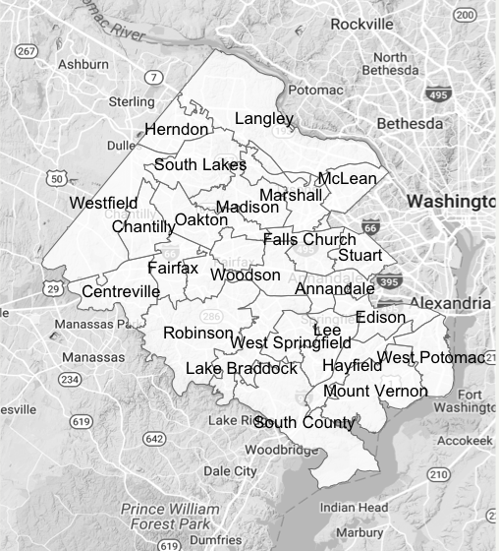
Example: Fairfax County, Virginia Supervisor Districts and High School Attendance Areas
Supervisor Districts
School Attendance Areas

Slide 28
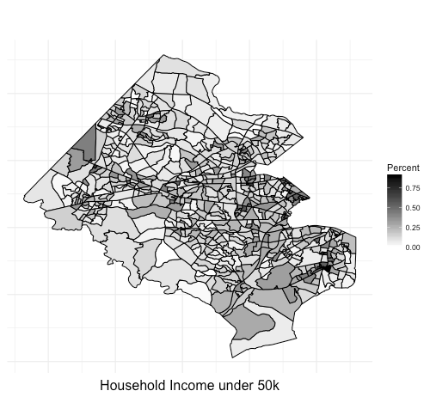
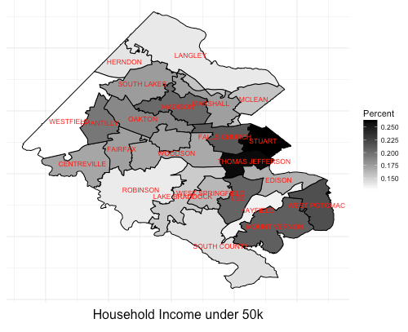
Change of support for aggregated data
Census Block Group
High School Pyramid Boundaries (synthetic population)
Fairfax County (2011-2015, 5-year estimate)

Slide 29
Example: Inferring household attributes in Arlington
Statistical
Sample
Local Data
housing price
tax amount from real estate tax assessments
ACS
Income summary
- by block group
ACS Microdata
housing price
tax amount
income
- county sample
Household level Imputation
housing price
tax amount
income

Slide 30
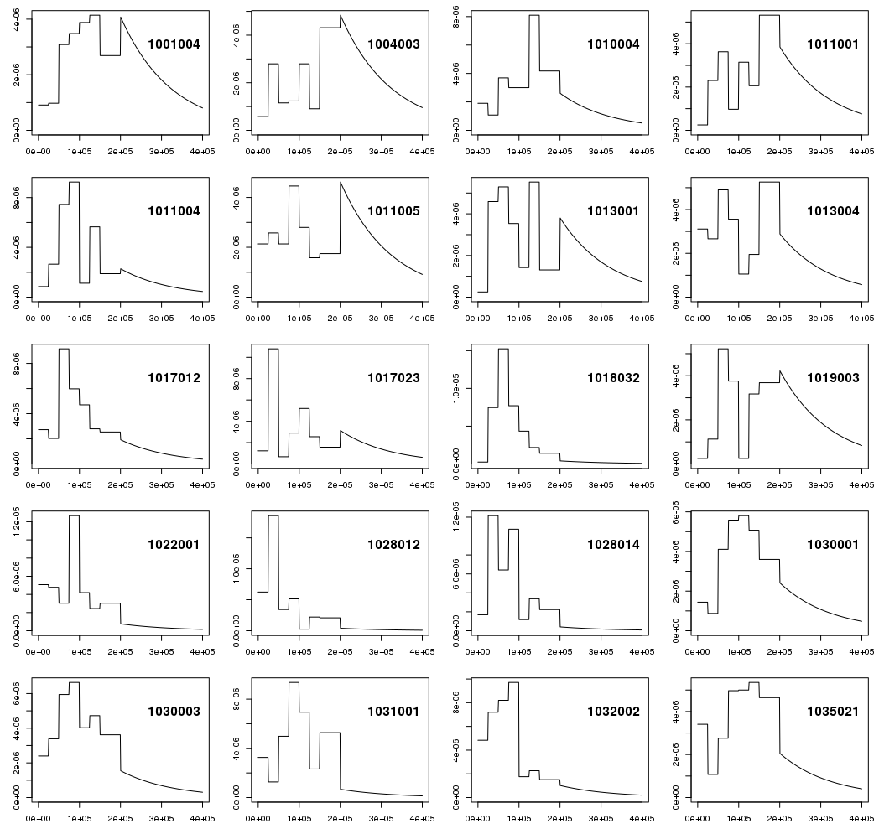
ACS Summary Tables by Block Group
Use summary counts from American FactFinder to create marginal distributions for a variable (e.g. household income) in each block group.

Slide 31
Results from identifiability
some realizations of Arlington
income for each house location
identifiability
histogram of # of unique houses in Arlington
histogram of # of unique records in a SRS of size HUD survey
CI’s for probability of a unique household for different block groups (same as picture?)
Medians plot by block group
expected number of identifiable units by block group map.
Be sure I list variables that are being “imputed” in the HUD sample
jg working on it!
jg working on it!
jg working on it!
jg working on it!

Slide 32
Methodology Update
Initial Synthetic Arlington realizations online
Using just 3 variables for now (housing price, household income)
Working to include apartments now
Clearly an important collection of housing units for domestic abuse
Most common police calls for DOME are at large apartment buildings
Not clear if the rate is higher since the number of units is higher.
Police call locations for DOME are currently being used as spatially located events for analysis
Initial approaches to link event locations to household locations
Nearest household location to DOME event is currently being used.
Will consider more model based approaches for making this link
Approaches will adapt ”smart scatter” methods producing domestic abuse events that are consistent with police records and aggregated counts from other sources (e.g. calls to Arlington CPS by zipcode).
Work is ongoing to include additional demographic variables.

Slide 33
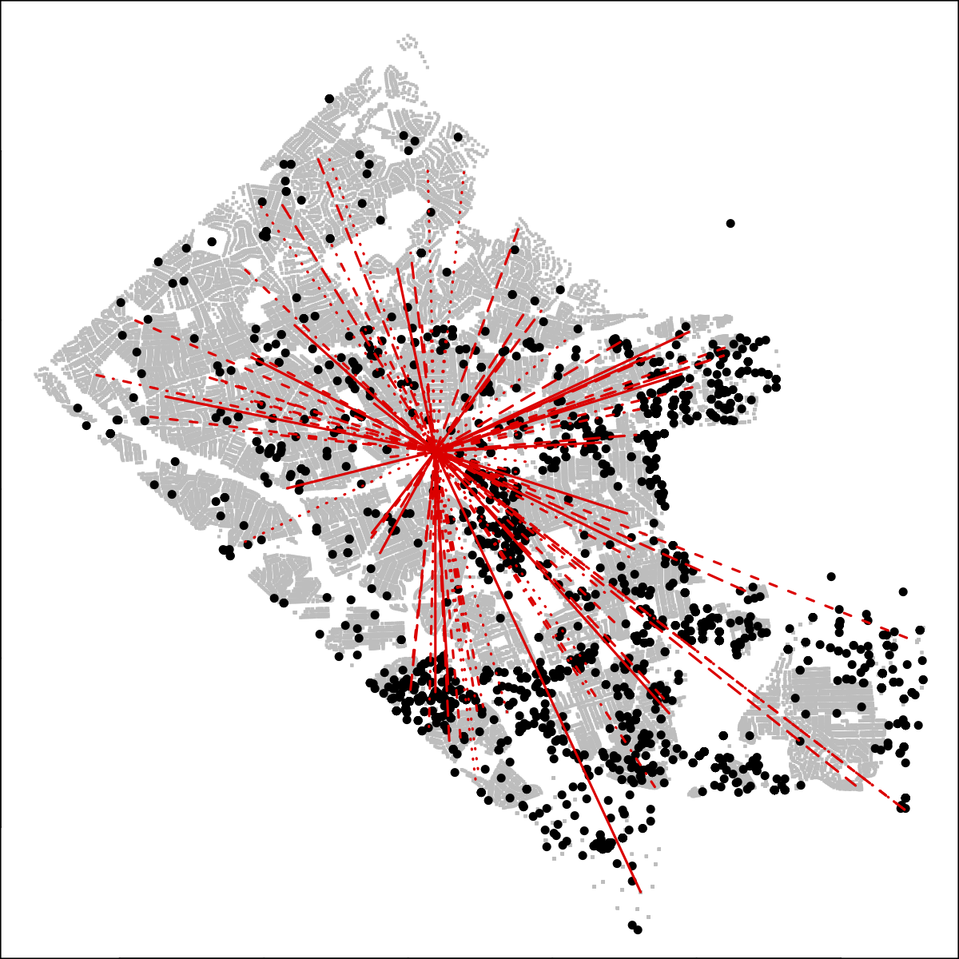
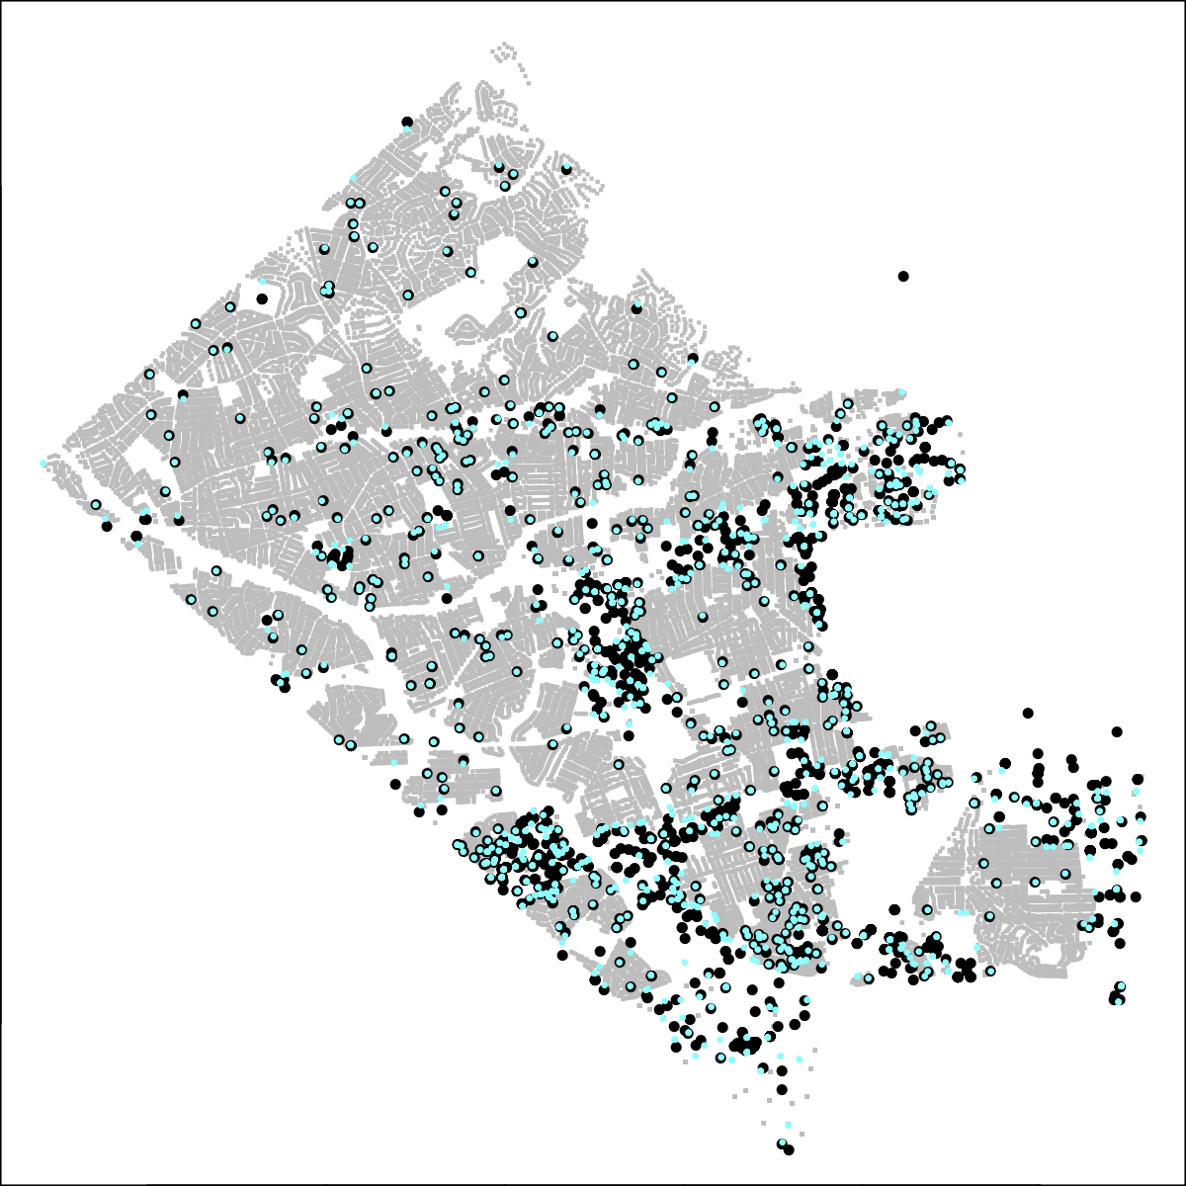
Initial linking based on distance to DOME event
distance from an event to different housing units
linking of DOME events ● to nearest housing unit ●

Slide 34
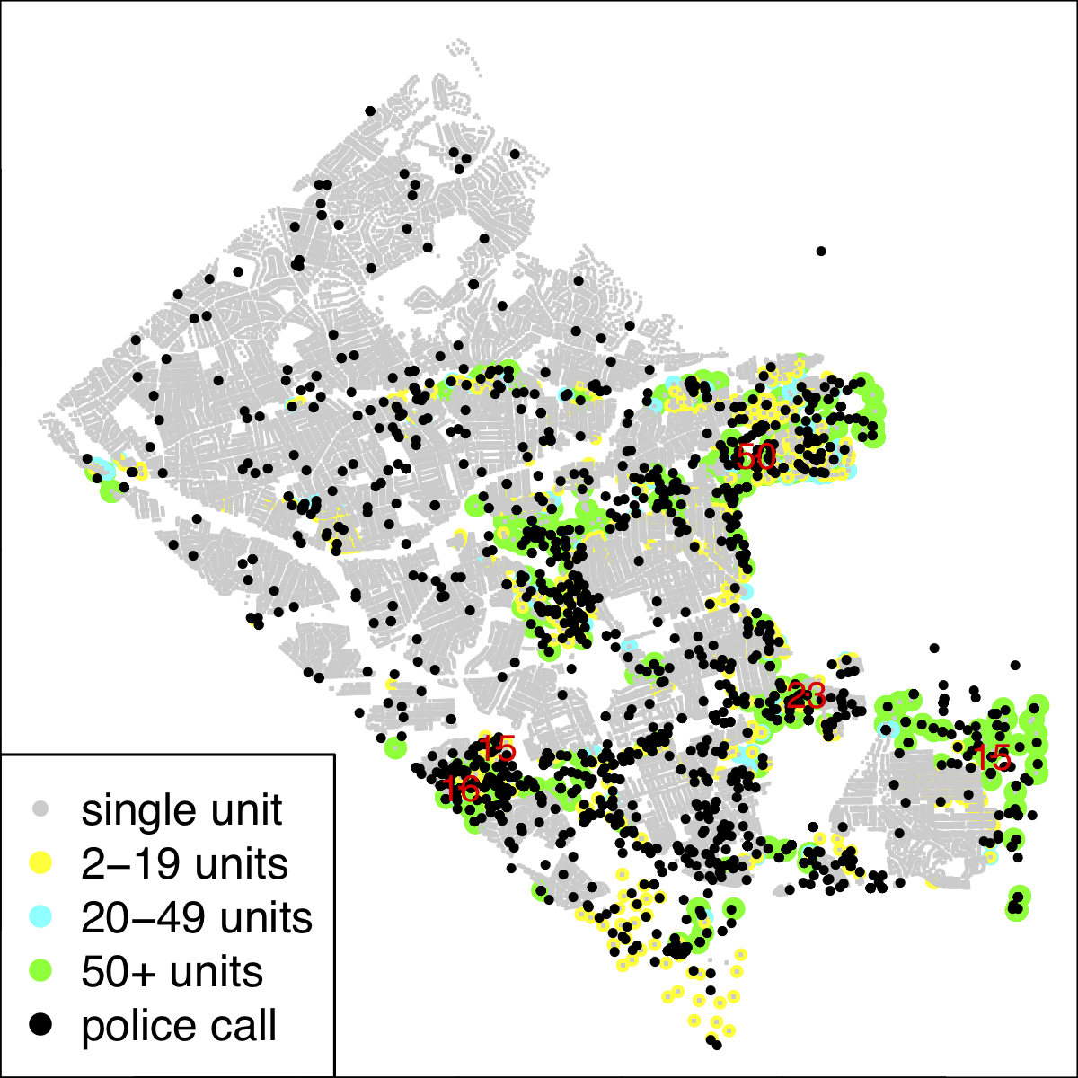
Arlington Housing Units and Arlington County Police Department (ACPD) Calls for Domestic Violence
Spatial patterns in locations for domestic dispute (DOME) calls to ACPD
Housing types also show a similar spatial pattern
Higher density of incidents corresponds to higher density of housing units
Housing data allows for local estimation of rates of DOME calls

Slide 35
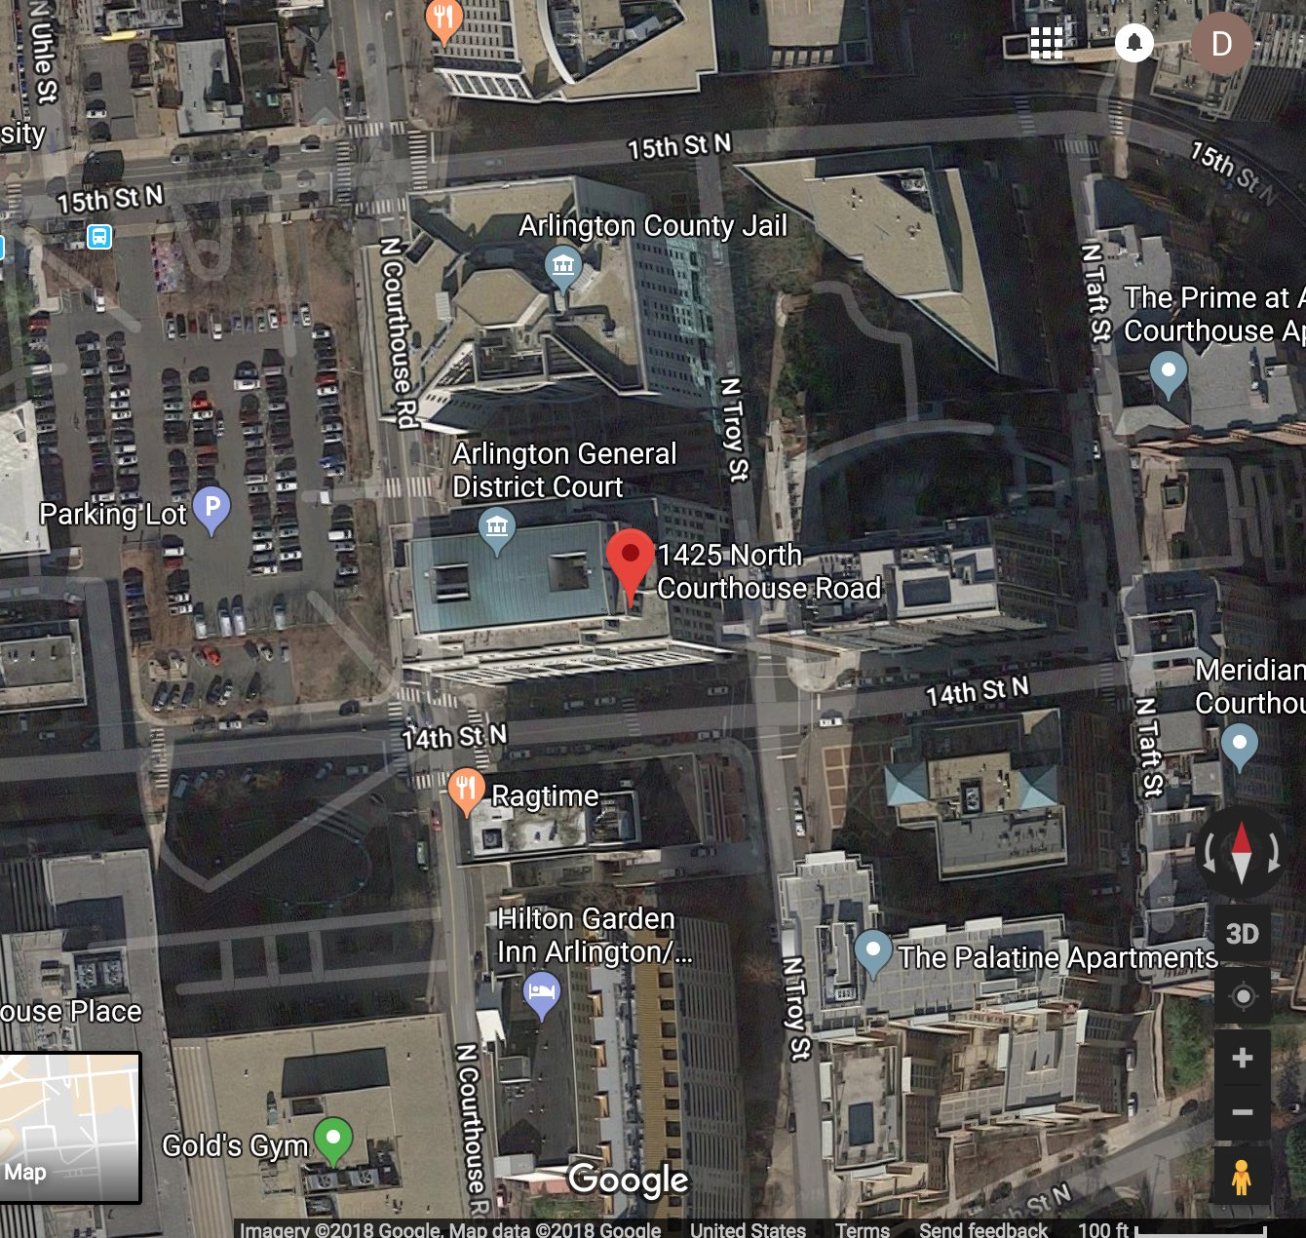
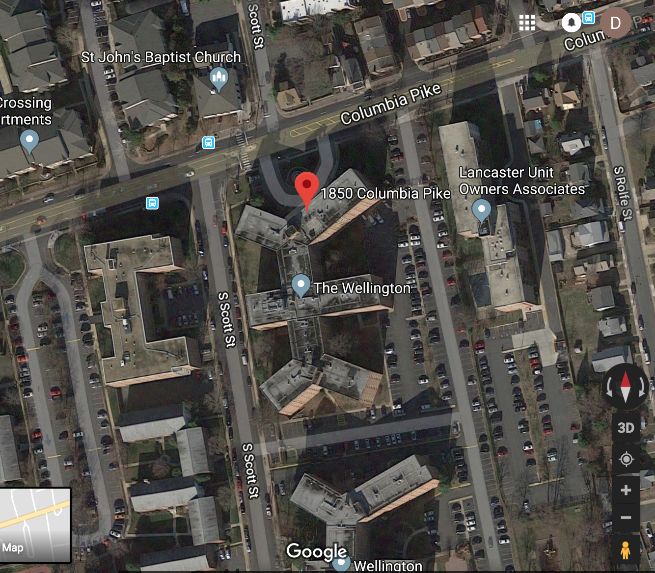
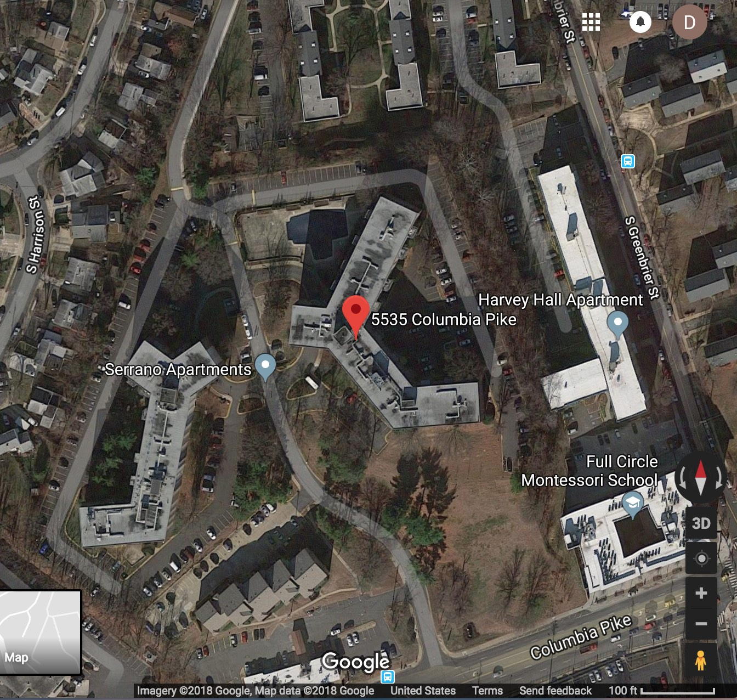
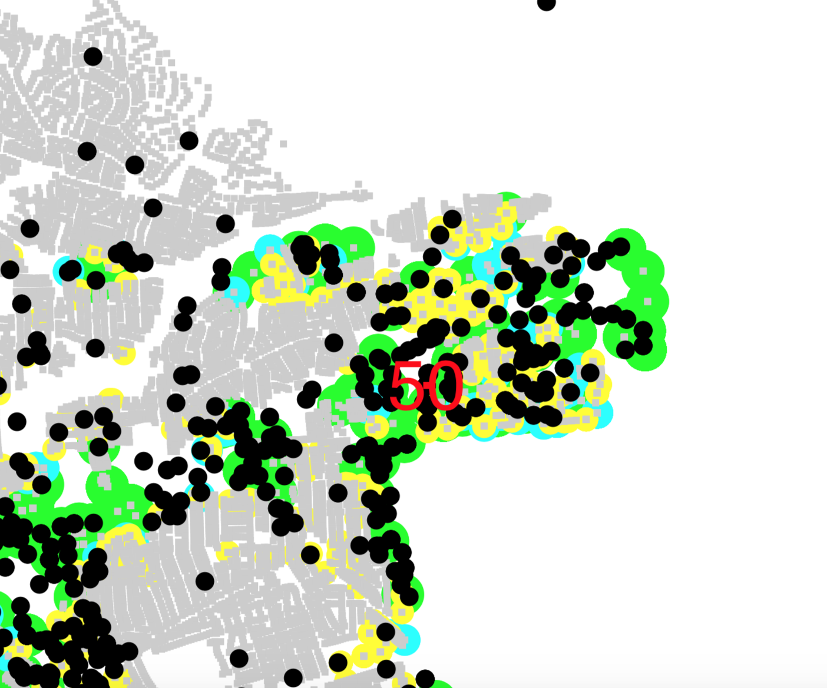
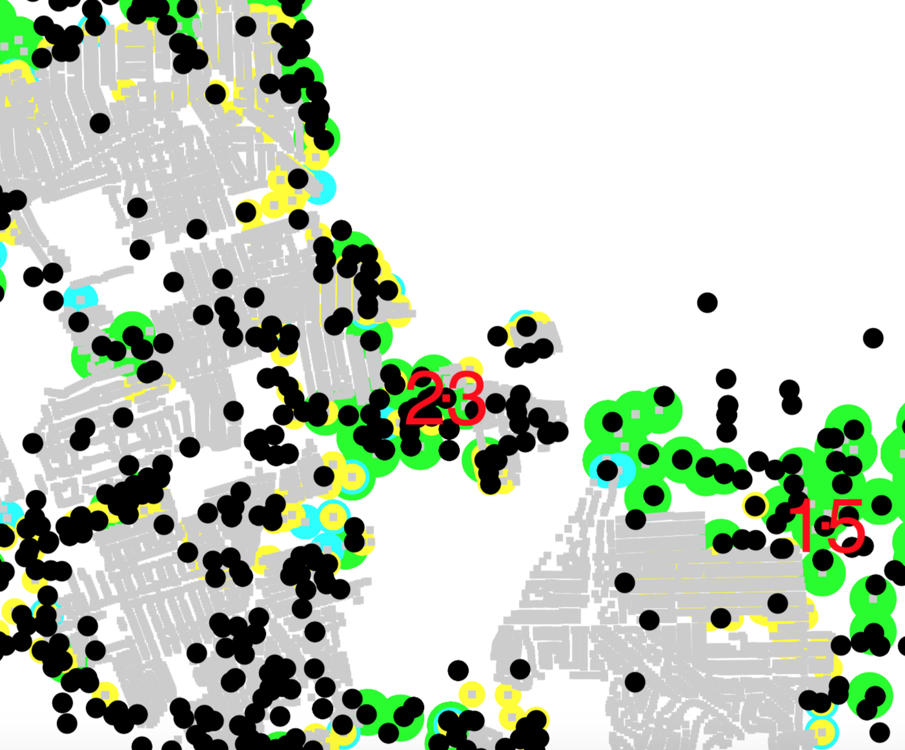
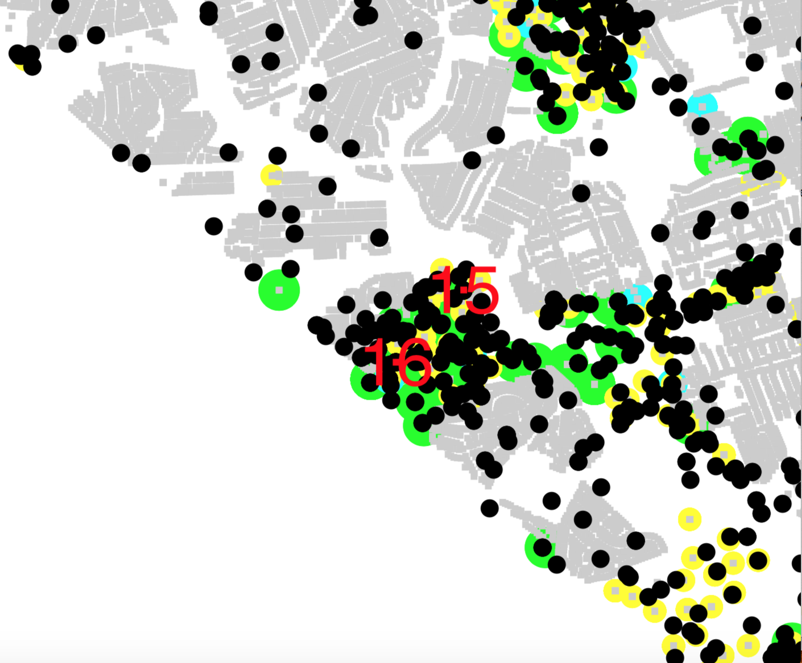
Arlington County Police Department Call for Service Data: Zooming in on High Count Repeat Locations
1425 N COURTHOUSE RD
1850 COLUMBIA PIKE
5535 COLUMBIA PIKE

Slide 36
Local Data Allows Estimation of Local Domestic Dispute Call Rates
Housing data allows for local estimation of rates of DOME calls
local tax records and apartment data allow estimation of the number of households in a region
half km radius about each of 5 points
Rates (# DOME events/half-km radius) for the 5 regions:
2
1
1 (red) | 2 (green) | 3 (dark blue) | 4 (teal) | 5 (pink)
0.001 | 0.000 | 0.011 | 0.015 | 0.002

Slide 37
Smart Scatter Model Challenges: Constructing Synthetic Arlingtons
housing units
Combine using state of the art concepts from:
Multiple Imputation
Synthetic population generation
Bayesian Computation
Generate plausible fine scale configurations of the population/system for prediction and quantifying uncertainty.
Posterior Realizations
incorporate information and uncertainty in data combination
demographics
Multiple data sources at various levels of aggregation.
realization 1
realization 2
•••
realization T
Local data sources relevant to understanding factors relating to domestic abuse calls:
Real estate tax records
Demographics (e.g. American Community Survey)
Local Police Responses
Local EMS Medical Responses
References:
Reiter, J. P., & Raghunathan, T. E. (2007). The multiple adaptations of multiple imputation. Journal of the American Statistical Association
Buuren, S., & Groothuis-Oudshoorn, K. (2011). MICE: Multivariate imputation by chained equations in R. Journal of Statistical Software
Beckman, R. J., Baggerly, K. A., & McKay, M. D. (1996). Creating synthetic baseline populations. Transportation Research Part A: Policy and Practice
Besag, J., Green, P., Higdon, D., & Mengersen, K. (1995). Bayesian computation and stochastic systems. Statistical Science
P(call)
P(call)
domestic violence calls
local
indicator
Statistically generated realizations allow separation of signal and noise at the local level.

Slide 38
Combining local data sources with a probabilistic representation of the local community
Posterior Realizations
incorporate information and uncertainty in data combination
housing units
Combine using state of the art concepts from:
Multiple Imputation
Synthetic population generation
Bayesian Computation
Generate plausible fine scale configurations of the population/system for prediction and quantifying uncertainty.
demographics
Multiple data sources at various levels of aggregation.
realization 1
realization 2
•••
realization T
Local data sources relevant to home and recreation safety among elderly include:
Real estate tax records
Demographics (e.g. American Community Survey)
Local EMS Medical Responses
Location and usage of recreation facilities
References:
Reiter, J. P., & Raghunathan, T. E. (2007). The multiple adaptations of multiple imputation. Journal of the American Statistical Association
Buuren, S., & Groothuis-Oudshoorn, K. (2011). MICE: Multivariate imputation by chained equations in R. Journal of Statistical Software
Beckman, R. J., Baggerly, K. A., & McKay, M. D. (1996). Creating synthetic baseline populations. Transportation Research Part A: Policy and Practice
Besag, J., Green, P., Higdon, D., & Mengersen, K. (1995). Bayesian computation and stochastic systems. Statistical Science
EMS incidents
Statistically generated realizations allow separation of signal and noise at the local level.

Slide 39
Imputation Scheme
Multivariate Imputation by Chained Equations (mice)
Each variable with missing data is modeled conditionally on other variables
Impute from each conditional distribution using Markov chain Monte Carlo methods; iterate until convergence
Advantages:
Natural framework for combining multiple partially observed data
Imputed draws are unique and not resampled from the PUMS (as in iterative proportional fitting)
van Buuren and Groothuis-Oudshoorn. "mice: Multivariate Imputation by Chained Equations in R."

Slide 40
Details of Demo example
house value, property tax, location from tax records
house value, property tax and HH income from ACS
income distribution by block group
➔ produce realizations of Arlington with incomes for each household that are compatible with the marginal income tables, the tax records, and the microdata.

